Slide 1


Chapter 6 Big Data
Instructor: He Li
Notes:
In this chapter, we talk about more sophisticated data management technologies, big data. We cover the definition of big data and its characteristics; NoSQL Databases; Hadoop and its ecosystem; and some Hands-on exercises.

Slide 2
Big Data
Definition: Data that exist in very large volumes and many different varieties (data types) that need to be processed at a very high velocity (speed).
Volume
quantity of data to be stored
Velocity
speed at which data is entered into system and must be processed
Variety
variations in the structure of data to be stored
Notes:
Traditional data management technologies were created to ensure accurate and efficient transaction processing. As we saw from the last chapter, later database structures were created to support decision-making and overall understanding of the business, which is what we called data warehouses. Big data takes us further down this road. Big data describes a new wave of data storage and manipulation possibilities and requirements. Organizations’ efforts to store, manipulate, and analyze this new wave of data represent one of the most urgent emerging trends in the data management field.
Big Data generally refers to a set of data that exist in very large volumes and many different varieties (data types) that need to be processed at a very high velocity (speed). You will see that different sources have different definitions of the term “big data“. But there is a set of characteristics generally associated with it. The three most common ones are volume, velocity, and variety.

Slide 3
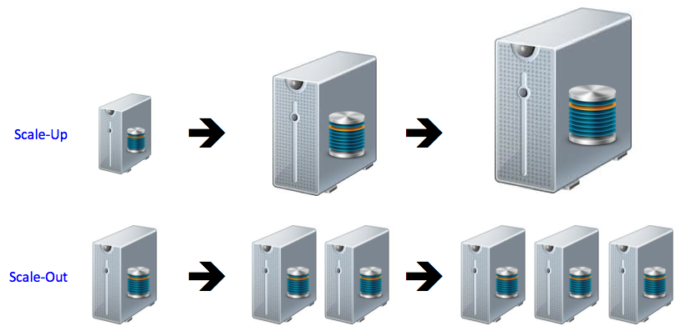
Big Data – Volume (extremely large storage capacities)
Scaling up: keeping the same number of systems but migrating each one to a larger system
Scaling out: when the workload exceeds server capacity, it is spread out across many servers
Notes:
Volume, the quantity of data to be stored, is a key characteristic of Big Data. The storage capacities associated with Big Data are extremely large. Naturally, as the quantity of data needing to be stored increases, the need for larger storage devices increases as well. When this occurs, systems can either scale up or scale out.
Scaling up is keeping the same number of systems but migrating each system to a larger system: for example, changing from a server with 16 CPU cores and a 1TB storage system to a server with 64 CPU cores and a 100 TB storage system.
On the other hand, scaling out means that when the workload exceeds the capacity of a server, the workload is spread out across a number of servers. This is also referred to as clustering—creating a cluster of low-cost servers to share a workload.

Slide 4
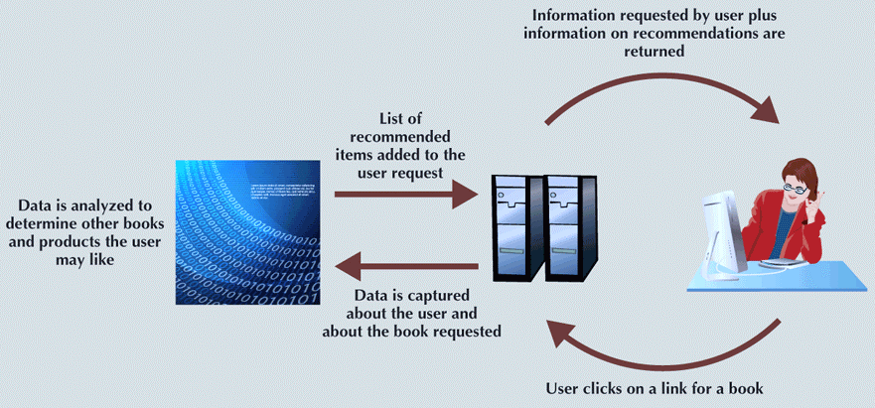
Big Data – Velocity (speed at which data is entered into system and must be processed)
Stream processing: focuses on input processing and requires analysis of data stream as it enters the system
Feedback loop processing: analysis of data to produce actionable results
Notes:
Velocity, refers to the rate at which new data enters the system and must be processed. In many ways, the issues of velocity mirror those of volume. For example, consider a web retailer such as Amazon. In the past, a retail store might capture only the data about the final transaction of a customer making a purchase. But now online retailers also capture every click of the mouse in the searching, browsing, comparing, and purchase process. Instead of capturing one event (the final sale) in a 20-minute shopping experience, it might capture data on 30 events during that 20-minute time frame—a 30× increase in the velocity of the data.
Other advances in technology, such as RFID, GPS, and NFC, add new layers of data-gathering opportunities that often generate large amounts of data that must be stored in real time. For example, RFID tags can be used to track items for inventory and warehouse management. The tags do not require line-of-sight between the tag and the reader, and the reader can read hundreds of tags simultaneously while the products are still in boxes. This means that instead of a single record for tracking a given quantity of a product being produced, each individual product is tracked, creating an increase of several orders of magnitude in the amount of data being delivered to the system at any one time.
In addition to the speed with which data is entering the system, for Big Data to be actionable, that data must be processed at a very rapid pace. The velocity of processing can be broken down into two categories: stream processing and feedback loop processing.
Stream processing focuses on input processing, and it requires analysis of the data stream as it enters the system. In some situations, large volumes of data can enter the system at such a rapid pace that it is not feasible to try to store all data. The data must be processed and filtered as it enters the system to determine which data to keep and which data to discard. For example, at the CERN Large Hadron Collider, the largest and most powerful particle accelerator in the world, experiments produce about 600 TB per second of raw data. Scientists have created algorithms to decide ahead of time which data will be kept. These algorithms are applied in a two-step process to filter the data down to only about 1 GB per second of data that will actually be stored.
Feedback loop processing refers to the analysis of the data to produce actionable results. While stream processing could be thought of as focused on inputs, feedback loop processing can be thought of as focused on outputs. The process of capturing the data, processing it into usable information, and then acting on that information is a feedback loop. This figure shows a feedback loop for providing recommendations for book purchases. Feedback loop processing to provide immediate results requires analyzing large amounts of data within just a few seconds so that the results of the analysis can become a part of the product delivered to the user in real time.

Slide 5
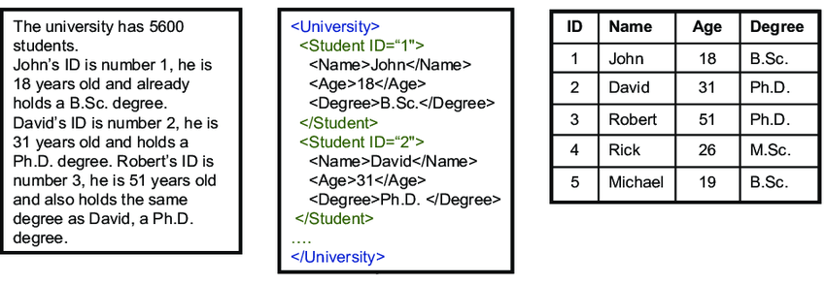
Big Data – Variety
Unstructured data:
does not fit into a predefined model
(e.g., maps, satellite images, emails, texts, tweets, and videos)
Semistructured data:
some parts of the data fit a predefined model while other parts do not
Structured data:
fits into a predefined data model
Notes:
In a Big Data context, variety refers to the vast array of formats and structures in which the data may be captured. Data can be structured, unstructured, or semistructured. Structured data is organized to fit a predefined data model. Unstructured data is not organized to fit into a predefined data model. Semistructured data combines elements of both—some parts of the data fit a predefined model while other parts do not.
Relational databases rely on structured data. A data model is created by the database designer based on the business rules. As data enters the database, the data is decomposed and routed for storage in the corresponding tables and columns as defined in the data model. Although much of the transactional data that organizations use works well in a structured environment, most of the data in the world is semistructured or unstructured.
Unstructured data includes maps, images, emails, texts, tweets, videos, transcripts, and a whole host of other data forms. Over the decades that the relational model has been dominant, relational databases have evolved to address some forms of unstructured data. For example, most large-scale RDBMSs support a binary large object (BLOB) data type that allows the storage of unstructured objects like audio, video, and graphic data as a single, atomic value. One problem with binary large object (BLOB) data is that the semantic value of the data is inaccessible and uninterpretable by data processing.
Big Data requires that the data be captured in whatever format it naturally exists, without any attempt to impose a data model or structure to the data. This is one of the key differences between processing data in a relational database and Big Data processing. Relational databases impose a structure on the data when the data is captured and stored. Big Data processing imposes a structure on the data as needed for applications as a part of retrieval and processing. One advantage to providing structure during retrieval and processing is the flexibility of being able to structure the data in different ways for different applications.

Slide 6
Other Characteristics of Big Data
Variability: changes in meaning of data based on context
Veracity: trustworthiness of data
Value: degree data can be analyzed for meaningful insight
Visualization: ability to graphically resent data to make it understandable
Relational databases are not necessarily the best for storing and managing all organizational data
Polyglot persistence: coexistence of a variety of data storage and management technologies within an organization’s infrastructure
Notes:
Characterizing Big Data with the 3 Vs is fairly standard. However, as the industry matures, other characteristics have been put forward as being equally important. Here are some examples. Variability refers to the changes in the meaning of the data based on context. While variety and variability are similar terms, they mean distinctly different things in Big Data. Variety is about differences in structure. Variability is about differences in meaning. Variability is especially relevant in areas such as sentiment analysis that attempt to understand the meanings of words. For example, the statements, “I just bought a new smartphone—I love it!” and “The screen on my new smart-phone shattered the first time I dropped it—I love it!” In the first statement the presence of the phrase “I love it” might help an algorithm correctly interpret the statement as expressing a positive attitude. However, the second statement uses sarcasm to express a negative attitude, so the presence of the phrase “I love it” may cause the analysis to interpret the meaning of the phrase incorrectly.
Veracity refers to the trustworthiness of the data. Can decision makers reasonably rely on the accuracy of the data and the information generated from it? This is especially pertinent given the automation of data capture and some of the analysis. Uncertainty about the data can arise from several causes, such as having to capture only selected portions of the data due to high velocity. Also, in terms of sentiment analysis, customers’ opinions and preferences can change over time, so comments at one point in time might not be suitable for action at another point in time.
Value refers to the degree to which the data can be analyzed to provide meaningful information that can add value to the organization. Just because a set of data can be captured does not mean that it should be captured. Organizations should only include data that can form the basis for analysis potentially impacting organizational behavior.
Visualization is the ability to graphically present the data in such a way as to make it understandable. Volumes of data can leave decision makers awash in facts but with little understanding of what the facts mean. Visualization is a way of presenting the facts so that decision makers can comprehend the meaning of the information to gain insights.
An argument could be made that these additional Vs are not necessarily characteristics of Big Data; or, perhaps more accurately, they are not characteristics of only Big Data. Veracity of data is an issue with even the smallest data store, which is why data management is so important in relational databases. Value of data also applies to traditional, structured data in a relational database. One of the keys to data modeling is that only the data that is of interest to the users should be included in the data model. Data that is not of value should not be recorded in any data store—Big Data or not. Visualization is an important tool in working with data warehouses, which are often maintained as structured data stores in RDBMS products. The important thing to remember is that these characteristics that play an important part in working with data in the relational model are universal and also apply to Big Data.
Even with the emergence of big data, relational databases are still widely used to store and manage structured data. But relational databases are not necessarily the best way for storing and managing all data. Now, the decision of whether to use a relational database at all is a real question. This has led to the coexistence of a variety of data storage and management technologies within an organization’s infrastructure. Scaling up is often considered a viable option as relational databases grow. However, it has practical limits and cost considerations that make it infeasible for many Big Data installations. Scaling out into clusters is the dominant approach that organizations are currently pursuing for Big Data management. As a result, new technologies not based on the relational model have been developed.
Next, we will discuss two specific categories of technologies that have become known as core infrastructure elements of big data solutions: NoSQL and Hadoop.

Slide 7
No S Q L (Not Only SQL)
Scaling out rather than scaling up
Natural for a cloud environment
Largely open source
NoSQL Category | Example Databases | Developer
Key-Value Databases | Redis Dynamo | Redis Labs Amazon
Document Databases | MongoDB CouchDB | MongDB, Inc Apache
Columnar Databases | Hbase Cassandra | Apache Apache (Originally Facebook)
Graph Databases | Neo4J GraphBase | Neo4j FactNexus
Notes:
The challenges of dealing with big data have led to the development of NoSQL databases. NoSQL databases reject many of the underlying assumptions of the relational model. NoSQL stands for not only SQL. NoSQL is a category of recently introduced data storage and retrieval technologies that are not based on the relational model. We will first learn about the general characteristics of these technologies and then explore them at a more detailed level using a widely used categorization into key-value, document, columnar, and graph databases. This tables provides some examples of NoSQL databases and their developers in each category. Interestingly, as shown in this table, many NoSQL DBMSs are based on technologies that have emerged from open source communities; for enterprise use, they are offered with commercial support.
In the relational database which we have been focusing on in this semester, we are trying to avoid duplication to save storage space. However, with the storage technologies improve, the price of storage is greatly reduced and minimizing storage space is no longer a key design consideration. Instead, we focus more on the scalability, flexibility, agility, and versatility. We also need to support complex analytics. This shift leads to the development of database models that provide an alternative to relational model. We often use an umbrella term of NoSQL to represent the special interest in contexts that require versatile processing of a rich variety of data types and structures.
Different from the relational databases (that focus on “scaling up”, which requires large stepwise investments in larger and larger hardware), NoSQL databases allow “scaling out” through the use of a large number of commodity servers that can be easily added to the architectural solution. In a NoSQL database, the distributed nature ensures that the failure of a single component will not lead to the failure of entire system. This model can be easily implemented in a cloud environment.

Slide 8
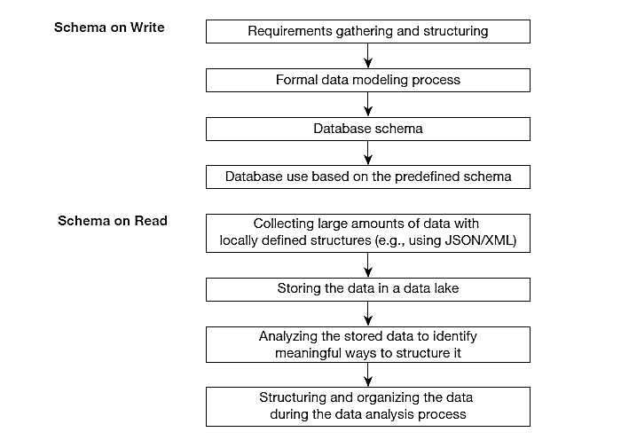
NoSQL
Supports schema on read
Not ACID compliant!
BASE – basically available, soft state, eventually consistent
Traditional database design
The big data approach
Notes:
NoSQL systems provides the opportunities for the use of the “schema on read” model instead of the “schema on write” model. Looking at this illustrative figure, in a relational database, schema on write means that we start from collecting requirements and then go through the linear process of conceptual data modeling and logical data modeling, which emphasize on the definition of database schema. We then use the database by writing queries based on the predefined schema. In contrast, with a schema on read approach, we firstly collect large amounts of data with logically defined structure and then store them in a data lake. We will structure and organize the data when we actually need to analyze them.
Thus, most NoSQL DBMSs do not support the ACID (atomicity, consistency, isolation, and durability) properties of transactions, which are typically considered important in the relational DBMS. Rather, NoSQL DBMS focus on the BASE principle, which stands for basically available, soft state, and eventually consistent, as we explained in the “schema on read”.

Slide 9
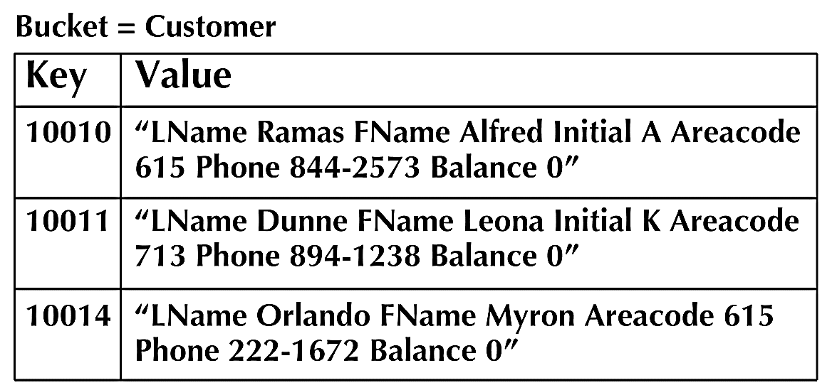
No S Q L Classifications: Key-Value Databases
A simple pair of a key and an associated collection of values. Key is usually a string. Database has no knowledge of the structure or meaning of the values.
Example: Redis
Notes:
Key-value (KV) databases are conceptually the simplest of the NoSQL data models. It stores data as a collection of key-value pairs. The key acts as an identifier for the value. The value can be anything such as text, an XML document, or an image. The database does not attempt to understand the contents of the value component or its meaning—the database simply stores whatever value is provided for the key. There are no foreign keys; in fact, relationships cannot be tracked among keys at all. This greatly simplifies the work that the DBMS must perform, making key-value databases extremely fast and scalable for basic processing.
Key-value pairs are typically organized into “buckets”, which can roughly be thought of as the key-value database equivalent of a table. A bucket is a logical grouping of keys. Key values must be unique within a bucket, but they can be duplicated across buckets. All data operations are based on the bucket plus the key. In other words, it is not possible to query the data based on anything in the value component of the key-value pair. All queries are performed by specifying the bucket and key.
This figure shows a customer bucket with three key-value pairs. Since the key-value model does not allow queries based on data in the value component, it is not possible to query for a key-value pair based on customer last name, for example. In fact, the key-value DBMS does not even know that there is such a thing as a customer last name because it does not understand the content of the value component. An application could issue a get command to have the key-value DBMS return the key-value pair for bucket customer and key 10011, but it would be up to the application to know how to parse the value component to find the customer’s last name, first name, and other characteristics. (Note: Be aware that although key-value pairs appear in tabular form in the figure, the tabular format is just a convenience to help visually distinguish the components. Actual key-value pairs are not stored in a table-like structure.)

Slide 10
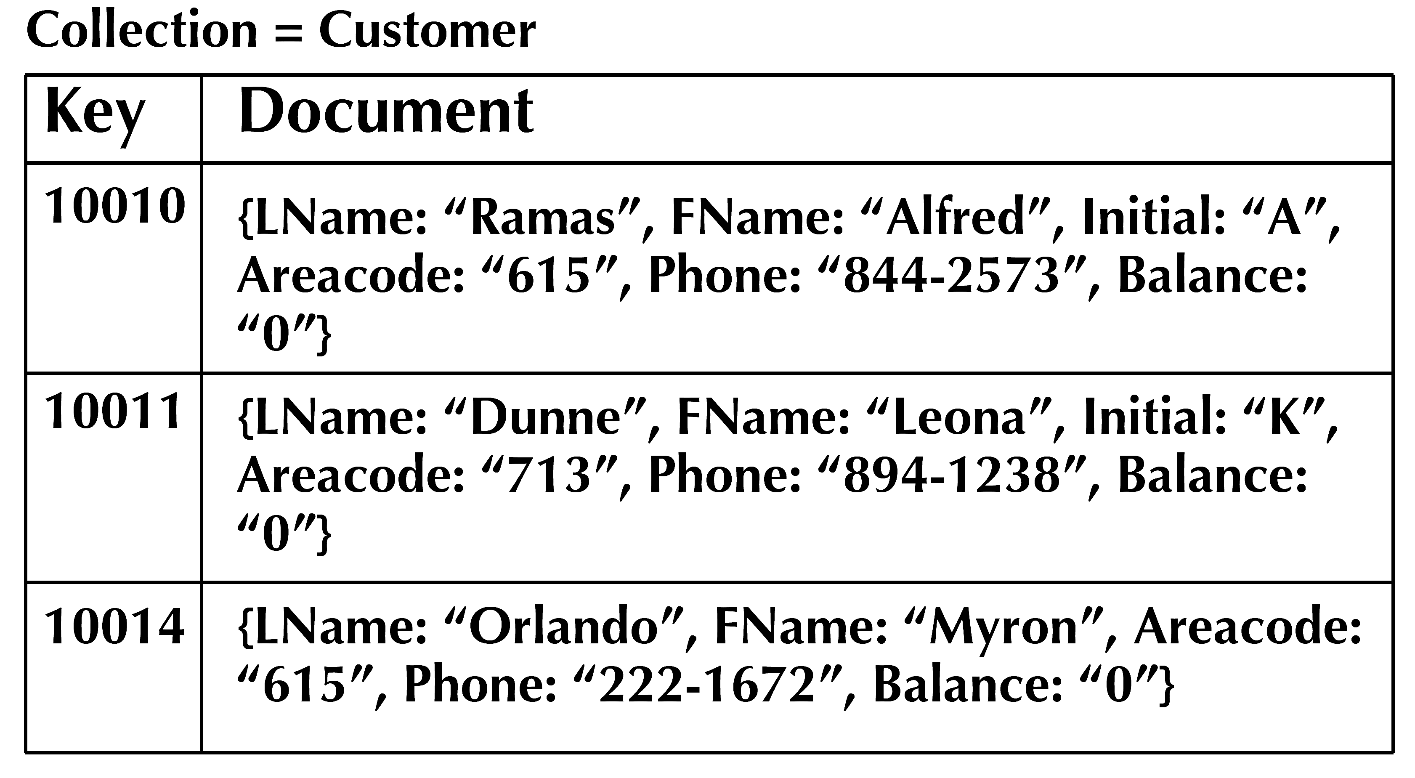
No S Q L Classifications: Document Databases
Like a key-value store, but “document” goes further than “value”. Document is structured so specific elements can be manipulated separately.
Example: Mongo DB
Notes:
Document databases are conceptually similar to key-value databases, and they can almost be considered a subtype of key-value databases. It stores data in tagged documents in key-value pairs. Unlike a key-value database where the value component can contain any type of data, a document database always stores a document in the value component. The document can be in any encoded format, such as XML, JSon(JavaScript object notation), or bSon(binary JSon). Another important difference is that while key-value databases do not attempt to understand the content of the value component, document databases do. Tags are named portions of a document. For example, a document may have tags to identify which text in the document represents the title, author, and body of the document. Within the body of the document, there may be additional tags to indicate chapters and sections. Despite the use of tags in documents, document databases are considered schema-less, that is, they do not impose a predefined structure on the data that is stored. For a document database, being schema-less means that although all documents have tags, not all documents are required to have the same tags, so each document can have its own structure. The tags in a document database are extremely important because they are the basis for most of the additional capabilities that document databases have over key-value databases. Tags inside the document are accessible to the DBMS, which makes sophisticated querying possible.
Document databases group documents into logical groups called collections. While a document may be retrieved by specifying the collection and key, it is also possible to query based on the contents of tags. For example, this figure represents the same data from the figure in last slide, but in a tagged format for a document database. Because the DBMS is aware of the tags within the documents, it is possible to write queries that retrieve all of the documents where the Balance tag has the value 0. Document databases even support some aggregate functions such as summing or averaging balances in queries.
We will get some hands-on practices of some basic operations in the MongoDB document database later in this chapter. There will be a separate MongoDB hands-on tutorial.

Slide 11
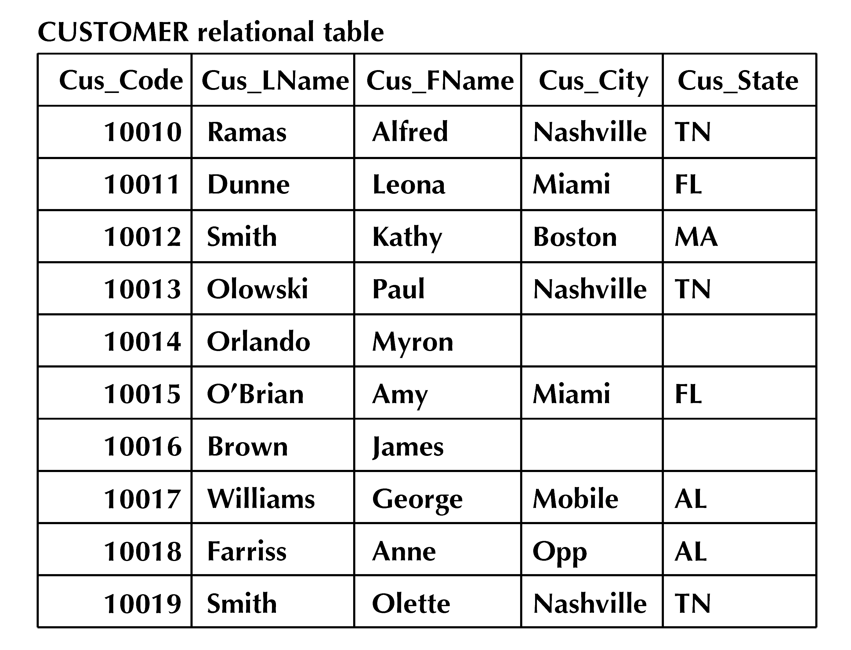
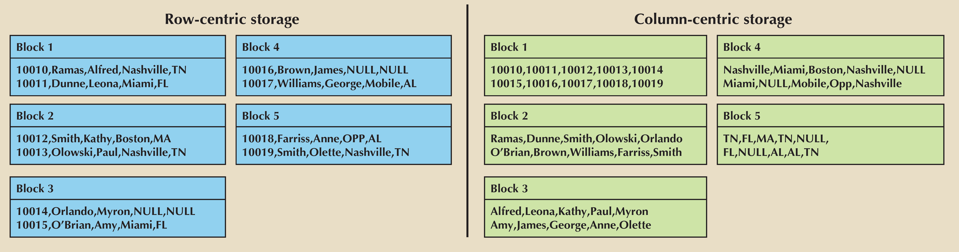
No S Q L Classifications: Columnar Databases
Rows and columns. Distribution of data based on both key values (records or rows) and columns, using “column groups/families”
Example: Apache Cassandra
Notes:
Columnar database can refer to two different sets of technologies that are often confused with each other. In one sense, columnar database can refer to traditional, relational database technologies that use column-centric storage instead of row-centric storage. Relational databases present data in logical tables; however, the data is actually stored in data blocks containing rows of data. All of the data for a given row is stored together in sequence with many rows in the same data block. If a table has many rows of data, the rows will be spread across many data blocks. Looking at this figure as an example. It illustrates a relational table with 10 rows of data that is physically stored across five data blocks. Row-centric storage minimizes the number of disk reads necessary to retrieve a row of data. Retrieving one row of data requires accessing just one data block, as shown in the figure.
However, in queries that retrieve a small set of columns across a large set of rows, a large number of disk accesses are required. For example, a query that wants to retrieve only the city and state of every customer will have to access every data block that contains a customer row to retrieve that data. In this figure, that would mean accessing five data blocks to get the city and state of every customer.

Slide 12
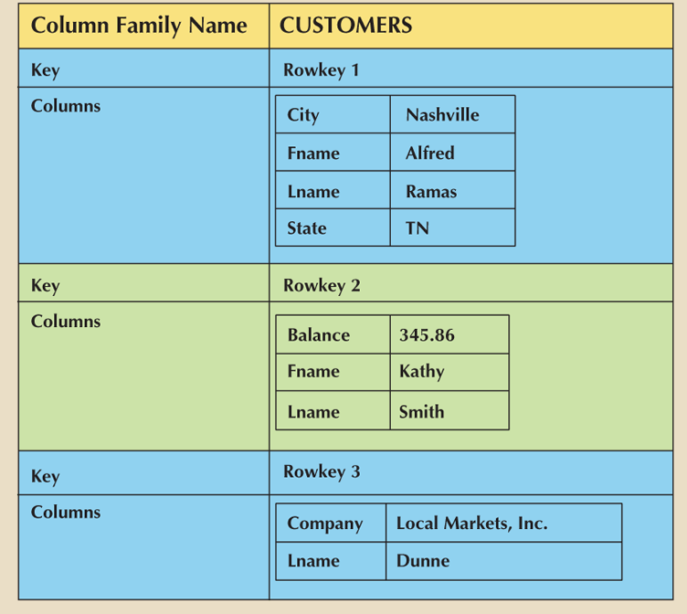
No S Q L Classifications: Columnar Databases
Notes:
The other use of the term columnar database, also called column family database, is to describe a type of NoSQL database that takes the concept of column-centric storage beyond the confines of the relational model. As NoSQL databases, these products do not require the data to conform to predefined structures nor do they support SQL for queries. This database model originated with Google’s BigTable product. Other columnar database products include HBase, Hypertable, and Cassandra. A column family database organizes data in key-value pairs with keys mapped to a set of columns in the value component. While column family databases use many of the same terms as relational databases, the terms don’t mean quite the same things. A column is a key-value pair that is similar to a cell of data in a relational database. The key is the name of the column, and the value component is the data that is stored in that column. Therefore, “cus_lname: Ramas” is a column; cus_lname is the name of the column, and Ramas is the data value in the column. Similarly, “cus_city: Nashville” is another column, with cus_city as the column name and Nashville as the data value.
As more columns are added, it becomes clear that some columns form natural groups, such as cus_fname, cus_lname, and cus_initial, which would logically group together to form a customer’s name. Similarly, cus_street, cus_city, cus_state, and cus_zip would logically group together to form a customer’s address. These groupings are used to create super columns. A super column is a group of columns that are logically related. Row keys are created to identify objects in the environment. All of the columns or super columns that describe these objects are grouped together to create a column family; therefore, a column family is conceptually similar to a table in the relational model. Although a column family is similar in concept to a relational table, this figure shows that it is structurally very different. Notice in the figure that each row key in the column family can have different columns.

Slide 13
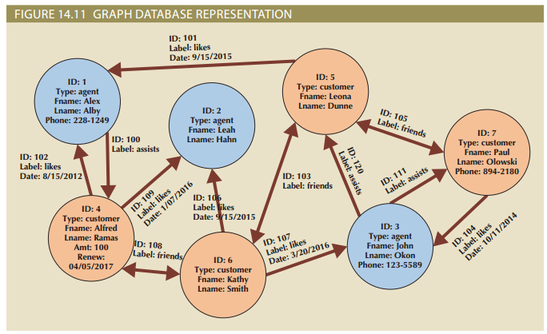
No S Q L Classifications: Graph Databases
Maintain information regarding the relationships between data items. Nodes with properties. Connections between nodes (relationships) can also have properties.
Example: Neo4j
Notes:
A graph database is based on graph theory to store data about relationship-rich environments. Graph theory models relationships, or edges, between objects called nodes. Interest in graph databases originated in the area of social networks, which has a wide range of applications beyond the typical Facebook, Twitter, and Instagram that immediately come to mind. Dating websites, knowledge management, logistics and routing, master data management, and identity and access management are all areas that rely heavily on tracking complex relationships among objects.
The primary components of graph databases are nodes, edges, and properties, as shown in the figure. A node corresponds to the idea of a relational entity instance. The node is a specific instance of something we want to keep data about. Each node represents a single agent. Properties are like attributes; they are the data that we need to store about the node. All agent nodes might have properties like first name and last name, but all nodes are not required to have the same properties. An edge is a relationship between nodes. Edges (shown as arrows in the figure) can be in one direction, or they can be bidirectional.
For example, in this figure, the friends relationships are bidirectional, but the likes relationships are not. Note that edges can also have properties. In the figure, the date on which customer Alfred Ramas liked agent Alex Alby is recorded in the graph database. A query in a graph database is called a traversal. Instead of querying the data-base, the correct terminology would be traversing the graph. Graph databases excel at traversals that focus on relationships between nodes, such as shortest path and degree of connectedness.

Slide 14

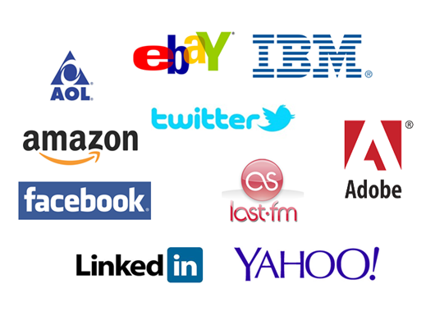
an open source implementation framework of MapReduce
the most talked about Big-Data data management product today
widely adopted in companies:
Notes:
There is probably no current data management product or platform discussed as broadly as Hadoop. This section of the chapter is to give you an overview of Hadoop and its ecosystem in order to help you better understand its importance and how to effectively use it.
Hadoop provides significant benefits for many big data management tasks. It has helped organizations achieve important analytics results in many industries such as retail, banking & finance, manufacturing, and healthcare. Companies including Facebook, Twitter, LinkedIn, Yahoo!, eBay, Adobe, Rackspace, Spotify … are all taking advantages of the Hadoop technologies.
However, it is also important to know that one does not fit all. Hadoop is one option in big data management toolbox that needs to be used for the right purposes.
A key feature of big data is highly distributed processing. The Internet allows you to do this, by sharing tasks across hundreds or thousands of computers. Hadoop’s essence is in processing very large amounts (terabytes or petabytes) of data by distributing the data and processing tasks among a large number of low-cost commodity servers. That means plain old PCs and servers. With the growing interest of big data analytics in organizations and the open source nature of Hadoop components, Hadoop is facilitating a large ecosystem consisting of more add-on open source projects for advanced analytics functionalities and needs, open source developers, commercial companies including both big public firms and raising startups, and end-users.

Slide 15
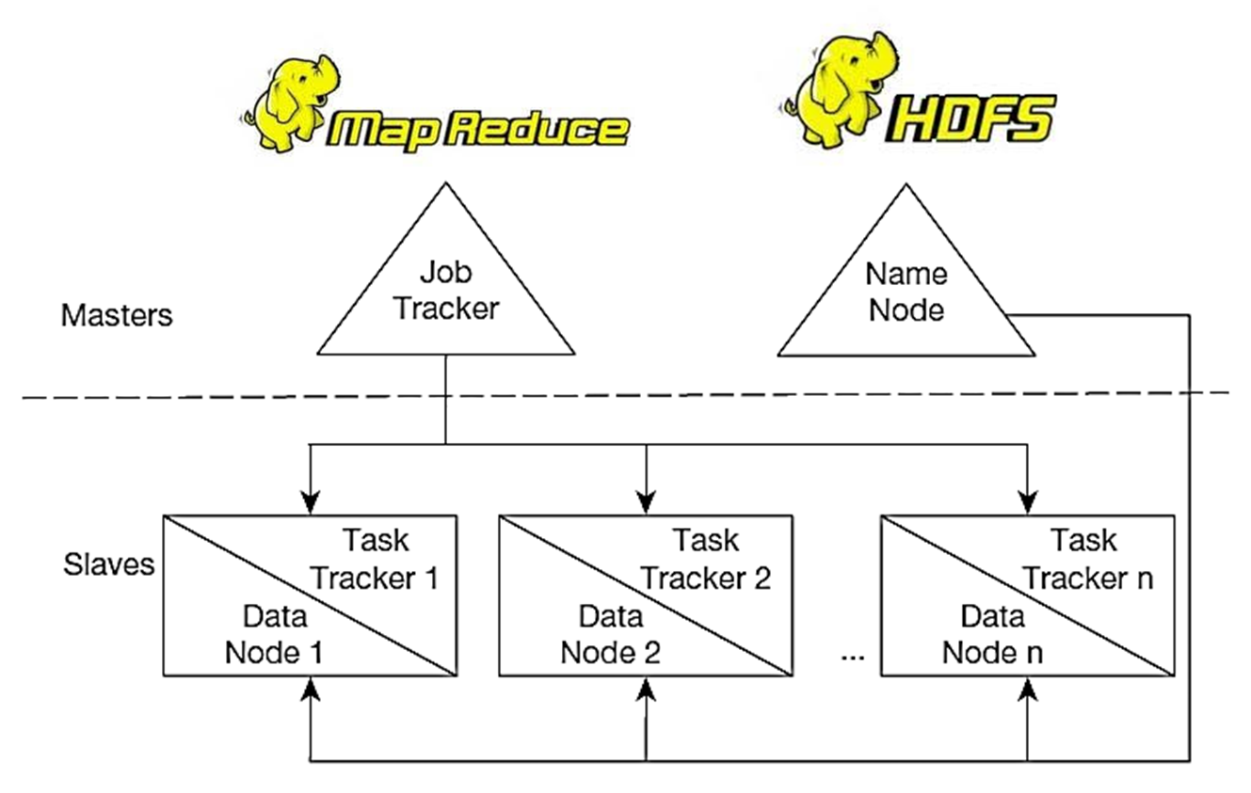
MapReduce: an algorithm for massive parallel processing of various types of computing tasks
HDFS: a file system designed for managing many large files in a distributed environment
Notes:
Hadoop is made up of the MapReduce engine and HDFS clusters, which are regarded as the core Hadoop components. The MapReduce engine includes an overall job tracker to manage activity on the entire cluster in the master server, and task trackers for each slave of the cluster. Each slave is a data node, and the master is a name node. Let’s look at this in more detail.

Slide 16
How Does HDFS Work?
Data
Block 1
Block 2
Block 3
Block 4
Block 5
Block 6
Data Node 1
Data Node 2
Data Node 3
Data Node 4
Block 1
Block 2
Block 1
Block 3
Block 2
Block 3
Block 1
Block 2
Block 4
Block 5
Block 5
Block 4
Block 5
Block 4
Block 3
Block 6
Block 6
Block 6
Notes:
First, How does a HDFS cluster work? With a large sized data, HDFS firstly breaks it into blocks and are replicated to ensure fault tolerance.
The replicated blocks are distributed on various nodes throughout a Hadoop cluster. In this example, the default replication factor of three, so each block appears on three data nodes. A node is just a computer that performs one or more types of tasks within the system.

Slide 17
How Does HDFS Work?
Metadata
File1: Blocks 1,3,4: r3
File 2: Blocks 2, 5, 6: r3
Client Node
Name Node
Block Report
Heartbeat
Data Node 1
Data Node 2
Data Node 3
Data Node 4
Block 1
Block 2
Block 1
Block 3
Block 2
Block 3
Block 1
Block 2
Block 4
Block 5
Block 5
Block 4
Block 5
Block 4
Block 3
Block 6
Block 6
Block 6
Notes:
Within the HDFS, there are three types of nodes. First, data nodes store the actual file data within the HDFS. Due to the replication of blocks, there are one or more data nodes in a Hadoop cluster.
Second, the name node contains the metadata for the file system. There is typically only one name node within a HDFS cluster. The metadata is designed to be small, simple, and easily recoverable. Keeping the metadata small allows the name node to hold all of the metadata in memory to reduce disk accesses and improve system performance. The metadata is composed primarily of the name of each file, the block numbers, and the desired replication factor for each file.
Third, the client node makes requests to the file system, either to read files or to write new files, as needed to support the user application.
Next, we describe the process of a HDFS task: when a client node needs to create a new file, it communicates with the name node.
The name node adds the new file name to the metadata; determines a new block number for the file; determines a list of which data nodes the block will be stored; and finally pass the information back to the client node.
The client node contact the first data node specified by the name node and begins writing the file on that data node. At the same time, the client node sends the data node the list of other data nodes that will be replicating the block. As the data is received from the client node, the data node contacts the next data node in the list and begins sending the data to this node for replication. This second data node then contacts the next data node in the list and the process continues with the data being streamed across all of the data nodes that are storing the block. Once the first block is written, the client node can get another block number and list of data nodes from the name node for the next block. When the entire file has been written, the client node informs the name node that the file is closed. The client node’s reading files will follow the same pattern of activities.
Periodically, each data node communicates with the name node. The data nodes send block reports and heartbeats. A block report is sent every 6 hours and informs the name node of which blocks are on that data node. Heartbeats are sent every 3 seconds and are used to let the name node know that the data node is still available,
Taken together, HDFS produces a powerful, yet highly specialized distributed file system that works well for the specialized processing requirements of big data applications. Next, we will consider how MapReduce provides data processing to complement data storage of HDFS.

Slide 18
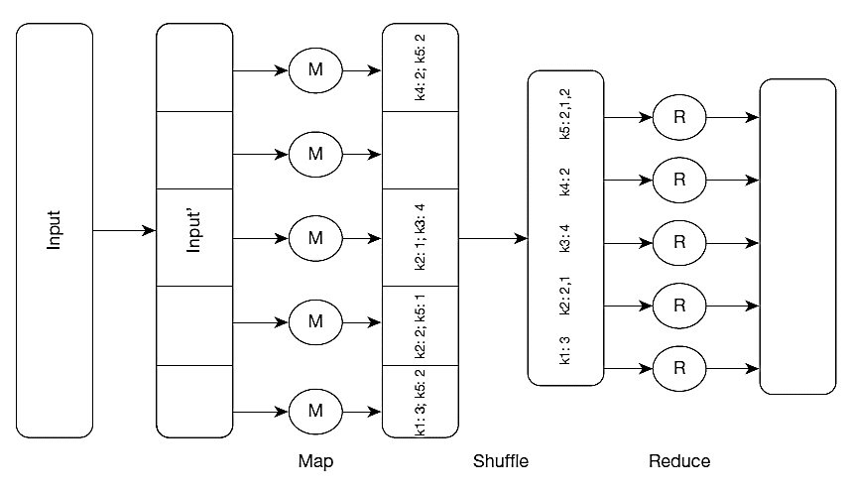
MapReduce
MapReduce: Simplified Data Processing on Large Clusters, Jeff Dean, Sanjay Ghemawat, Google, I n c., https://research.google.com/archive/mapreduce-osdi04-slides/index-auto-0007.html. Courtesy of the authors.
Notes:
MapReduce enables parallelization of data storage and computational problem solving via many commodity servers. The core idea of MapReduce is to divide a computing task so that multiple nodes can work on local data doing local processing at the same time. As the name suggested, there are two major steps: Map and Reduce. The map stage divided for local processing, and the reduce stage integrates the results of the individual map processes.
Let’s look at this example with the form of data in key-value pairs. So, the keys in the figure are k1, k2, etc. Assume that the problem is to get an overall count of how many times the key appears in the data. For example, consider that the keys are customer IDs and the values are individual orders for each customer. So, we’re trying to figure out how many orders each customer made. Also assume that the original input data is very, very, very large. In other words, bigger than what a single relational DBMS can handle.
The original input data is received at the master and then divided into subsets, each of which goes to an individual slave node. So, each slave node gets some number of sales orders. This is the map process. There may be hundreds of these nodes.
Each node works on its subset of the data. Its task is to find out how many orders for each customer. So for example, the node at the bottom found 3 k1 orders and 2 k5 orders. Note that multiple nodes may have found examples of the same key. For instance, k2 is found in two of the nodes.
The shuffle step is at the end of mapping, and merges all the map outputs and packages them for the reduce phase. At this point, we’ve collected all results and grouped them by key value.
The reduce stage integrates the results of each of the map processes, creating the final result
It is up to the developer to define the mapper and the reducer so that they together get the work done. So, MapReduce programming involves writing code to do the mapping and writing code to do the reducing.

Slide 19
Hadoop Ecosystem
Data Management
(e.g., ZooKeeper; Ambari; Oozie)
Data Access
(e.g., Hive; Pig; Mahout; Solr)
Data Governance
(e.g. Kafka; Storm; Sqoop)
Data Security
(e.g. Sentry; Knox Gateway)
Data Processing
(e.g., MapReduce; YARN)
Development Tool
HDFS
NoSQL Database
(e.g., HBase; Cassandra; MongoDB)
Hardware
Cloud
Notes:
Hadoop ecosystem consists of more big data analytics projects beyond the HDFS and MapReduce.
HDFS stores large files on a cluster of commodity hardware. Similarly for storage purpose, there are various NoSQL databases are developed to store unstructured data, including columnar, key-value, document, and graph databases such as HBase, Cassandra, and MongoDB.
On top of data storage, Hadoop provides MapReduce and YARN for data processing; MapReduce is the software programming model for processing data stored in HDFS. YARN provides resource management, and allows multiple data processing engines, for example real-time streaming, data science, and batch processing.
After the big data is processed, we can analyze and query the processed data, implementing structured queries and analytics algorithms. Some projects belonging to this layer include: Hive, A data warehouse infrastructure that provides data summarization and ad hoc querying; Pig, A high-level data-flow language and execution framework for parallel computation; Mahout, A Scalable machine learning and data mining library; Avro, data serialization system. Solr: Solr is highly reliable, scalable and fault tolerant, providing distributed indexing, replication and load-balanced querying, automated failover and recovery, centralized configuration and more. Solr powers the search and navigation features of many of the world's largest internet sites.
At the data management layer is where we manage the analytics process and Hadoop clusters. For example, ZooKepper offers coordination services for distributed applications such as maintaining configuration information, naming, providing distributed synchronization, and providing group services. Ambari makes Hadoop management simpler by developing software for provisioning, managing, deploying, and monitoring Hadoop clusters. Oozie is a workflow scheduler system to manage Hadoop jobs.
Since organizations often have their data from different sources in multiple formats such as ERP systems, relational databases, and other external sources. Hadoop has a data governance layer focusing on data integration, meta-data exchange, data formats, data streaming, and data injection, etc.
Hadoop also cares about data security. This layer focuses on the security of Hadoop-related workflows. It enhances the security of data and information.
There are also some vendors offering hardware appliances and cloud platforms for Hadoop-related projects such as HP, Dell, and AWS.
Since Hadoop is an open source platform, there are open resources aiming at supporting developers’ product development, which we label as development tool layer.

Slide 20
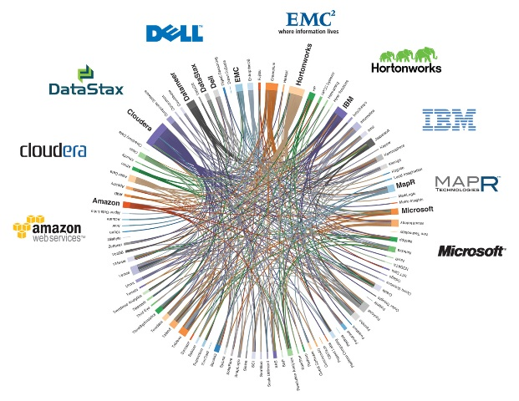
Hadoop Vendors
Notes:
This layered architecture of the Hadoop platform provides entrepreneurial opportunities. Firms focusing on producing Hadoop-related products/service can have unique strategies of developing their business models. Firms like Cloudera and Hortonworks provide software solutions while HP offers hardware appliances, and Google Cloud Platform and Amazon Web Services develop cloud platforms. Firms such as DataStax may focus on a single layer of Hadoop architecture; meanwhile, Hortonworks, Cloudera, and MapR Technologies work with multiple layers.
As a consequence, companies who don’t have sufficient big data analytics capabilities can buy from these commercial vendors. Well, companies with stronger R&D or technical capacities can take advantage of the open source Hadoop framework to customize their own internal solutions.

